Slide 1


A Presentation on
Query Processing and Optimization of Parallel Database System in Multi Processor Environment
Under Guidance of –
Prof. Uma S.
By –
Nitin Singh
17BCS019

Slide 2
INTRODUCTION
Query one of the key reasons for the success of RDBMS technology is the use of declarative languages and query optimization.
In any database the user can write a query for what data needs or to be retrieved and the database takes over the task of finding the data through efficient technique
It is the job of the query optimizer, optimization process deals with the efficiency of the query to evaluate other alternative methods of executing a query, and selecting the best execution method.
The advance database systems have coincided with noticeable developments in distributed computing and processing technologies.

Slide 3
Parallel database systems combine data management and parallel processing techniques to provide high performance, high-availability and scalability for data intensive applications.
An ideal approach on a parallel machine would scale easily at a low-cost, and would demonstrate linear speedup and scale up for number of processors.
Mainly two architectures have emerged from the quest for an ideal parallel machine
Shared-memory (SM)
shared-nothing (SN)

Slide 4
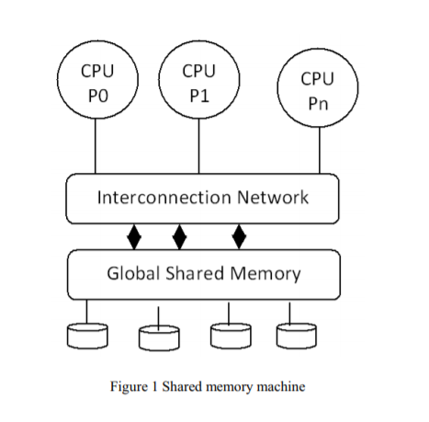
Shared memory architecture
It has no data transmission cost ,processors exchange messages and data through the shared memory.
This also makes it easier to synchronize processes.
load imbalance can be corrected with minimal overhead.
The weakness of such a system is the difficult to manage problem of conflicts.
If the number of processors is less then Shared memory architecture can be scaled.

Slide 5
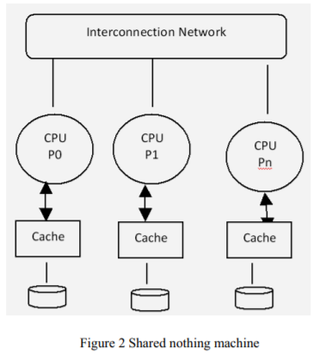
Shared-nothing architecture
It is the just opposite of Shared memory.
This architecture machine works on the principle of ownership, that each processor/node in a cluster has individual ownership of the data on that node .
The main advantage of shared-nothing is its ability to scale to hundreds and potentially thousands of processors.
Shared-nothing architecture designed mainly due to its high reliability and ease of scalability to hundreds of processors.
It depends on a high bandwidth interconnection network for effective message exchange.

Slide 6
Parallel Query Execution
In parallel database system PQO(parallel query option) allows one to break-up a given SQL statement so that its parts can run simultaneously on different processors in a multi processor machine.
Typical operations that can run in parallel are: full table scans, sorts, sub-queries, data loading etc.
Parallel Query allows one to break SELECT or DML statements into multiple smaller chunks and have PQ slaves execute those smaller chunks on separate CPU's.

Slide 7
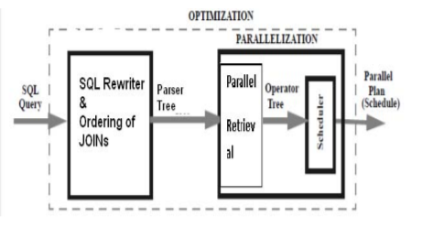
The first part is ordering and rewriting, produce a query tree that fixes aspects such as the order of joins and the strategy for computing each join.
Parallelization convert the query tree into the parallel plan. Parallelization also breaks this phase into two steps, parallelism extraction followed by scheduling

Slide 8
Query Processing and Optimization Approach in Parallel Database
A parallel database system should maintain the following characteristics:
Concurrency Management
Task Synchronization
Resources sharing
Data Placement
Network Scaling

Slide 9
First approach (When memory module not shared)
1) Separate the all relations along with it predicates those are use in users query.
2) Assign the separate relation to separate processor / CPU along with its memory module.
3) Transfer the intermediates result set with predicates to other CPU to evaluate result.
4) Repeat step 3 till all predicates not evaluated.
The above four steps are only for retrieve / select statements.

Slide 10
If the SQL statements update or insert statements
1)Partitioning: distributing the tuples of a relation over several disks / memory modules which will help to allow parallel databases to exploit the I/O bandwidth of multiple disks by reading and writing them in parallel or Relations are
de clustered (partitioned horizontally) based on range index ,hash function methods.
2) Each CPU accesses the separate memory module and insert or update the data in the database in the accessible memory module. Note when the CPU will access the cluster of database, concurrency control protocols (lock mechanism) must be enable.
3)Combine the all memory module and transfer the data into the data file.

Slide 11
Second approach (When memory module shared)
1) Partitioning: distributing the tuples of a relation over several disks / memory modules which will help to allow parallel databases to exploit the I/O bandwidth of multiple memory module (any memory module access by any processor/CPU) by reading and writing them in parallel or Relations are de clustered (partitioned horizontally) based on round robin, range index ,hash function methods.
2) In case of select / retrieval statements apply the block level locking mechanism with read lock. So that one CPU access (retrieve) the data it should be lock for other CPU till the complete execution of SQL statement.
3) If the SQL statement belongs in update statement category then apply the record level locking mechanism with read and write lock. Once the record will update by CPU, with the help of cache coherence property update the data in all corresponding memory module.

Slide 12
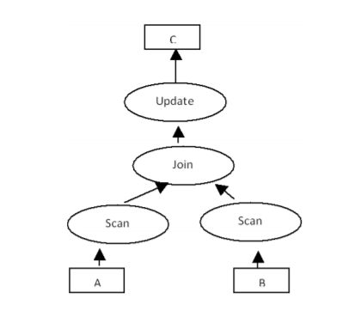
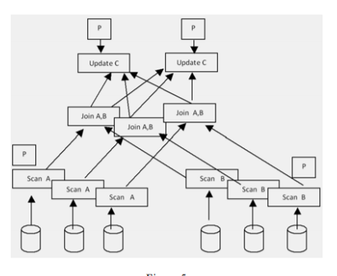
Example
Consider the following query:
Update t into C values (select t from A, B where A.x = B.y);
Simple conventional plan
multiprocessor environment
response time will be minimize and system throughput increase dramatically.

Slide 13
Thank you

